Slide 1
AI-Powered Chinese/German Document Review Assistant
Problem Statement
Reviewing Word or PDF documents that exceed 500 pages and contain Chinese or German content is a time-intensive task. Manually checking formatting, consistency, language quality, and table layouts across hundreds of pages requires significant effort and increases the risk of overlooking defects.
Who It Affects
Technical writers, localization teams, documentation reviewers, and quality assurance teams.
Input
Chinese or German Word (.docx) or PDF document
Output
Review report
Language errors
Formatting issues
Table formatting issues
Optional auto-fixes
What Good Looks Like
Minutes instead of hours of review
Consistent multilingual documents
Faster defect detection and correction
Notes:
Problem, input, output and success criteria.

Slide 2
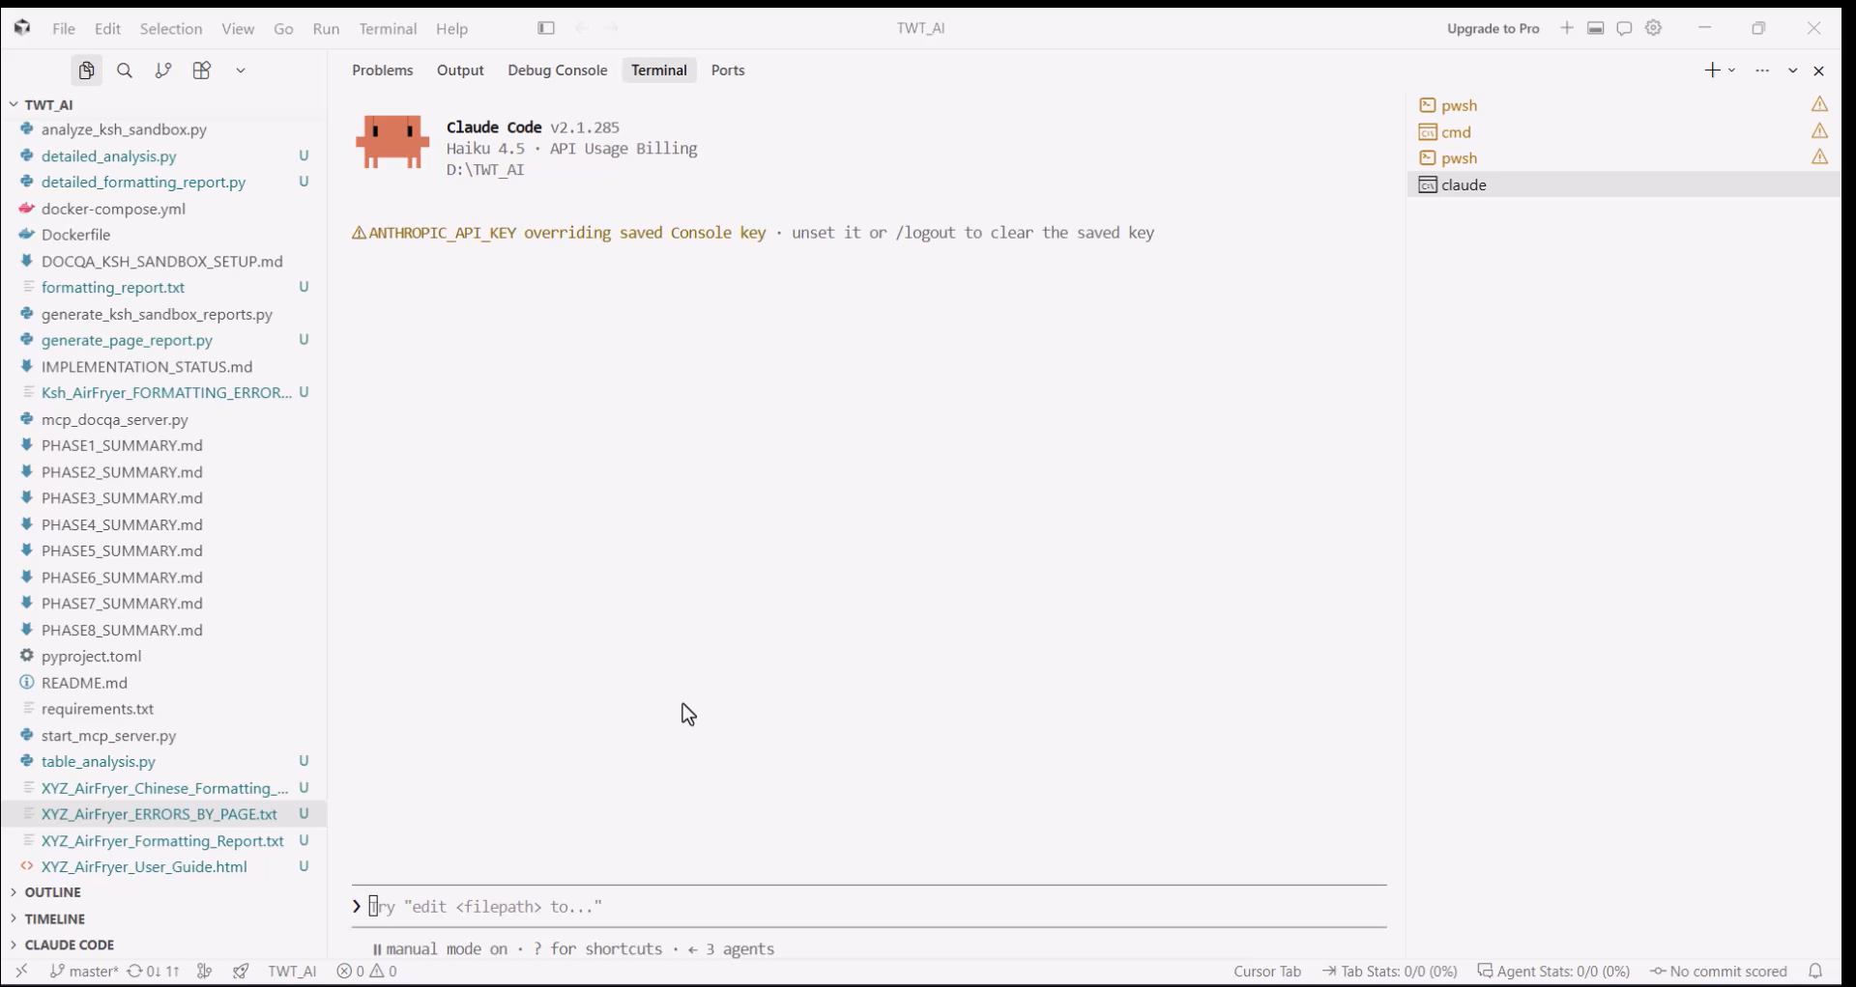
Demo Video
Demo Flow:
Initialize the Doc Agent and MCP server.
Upload Word/PDF document.
MCP Server detects document type and language.
Analysis of formatting, language, and tables.
Review report generated.
Auto-fix errors when prompted.
Display corrected output.

Slide 3
Workshop Learnings and Repository
Techniques Applied
Prompt engineering for review workflows
MCP server architecture for tool integration
Language detection automation
Multi-step review workflow (detect -> analyze -> report -> fix)
Structured error reporting
Automated document correction
Where They Were Used
Prompts: to identify language and review criteria
MCP Server: to orchestrate document analysis tools
Workflow: input processing to final report generation
Auto-fix: to correct detected issues on demand
GitHub Repository
GitHub - bhagwatkshitija-InfoDev/TWT_AI_Ksh_Sandbox at master

